Slide 1
Chapter 7
Chapter 7
SNMPv3
Network Management: Principles and Practice
© Mani Subramanian 2000
7-1

Slide 2
Chapter 7
Key Features
Modularization of document
Modularization of architecture
SNMP engine
Security feature
  Secure information
  Access control
  Notes
Network Management: Principles and Practice
© Mani Subramanian 2000
7-2

Slide 3
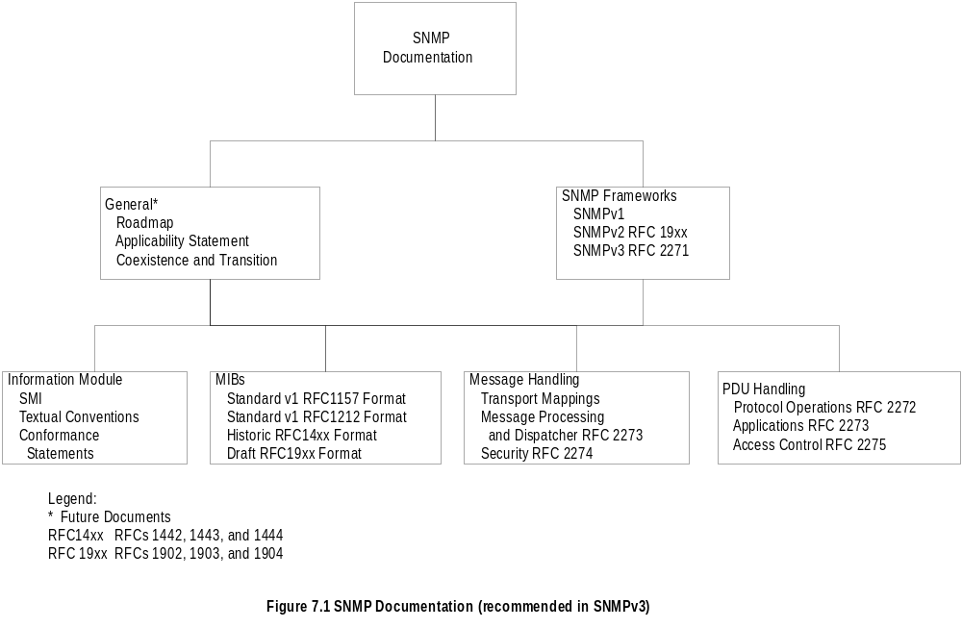
Chapter 7
Documentation
Compare this to the document organization in Chapter 4
Network Management: Principles and Practice
© Mani Subramanian 2000
7-3

Slide 4
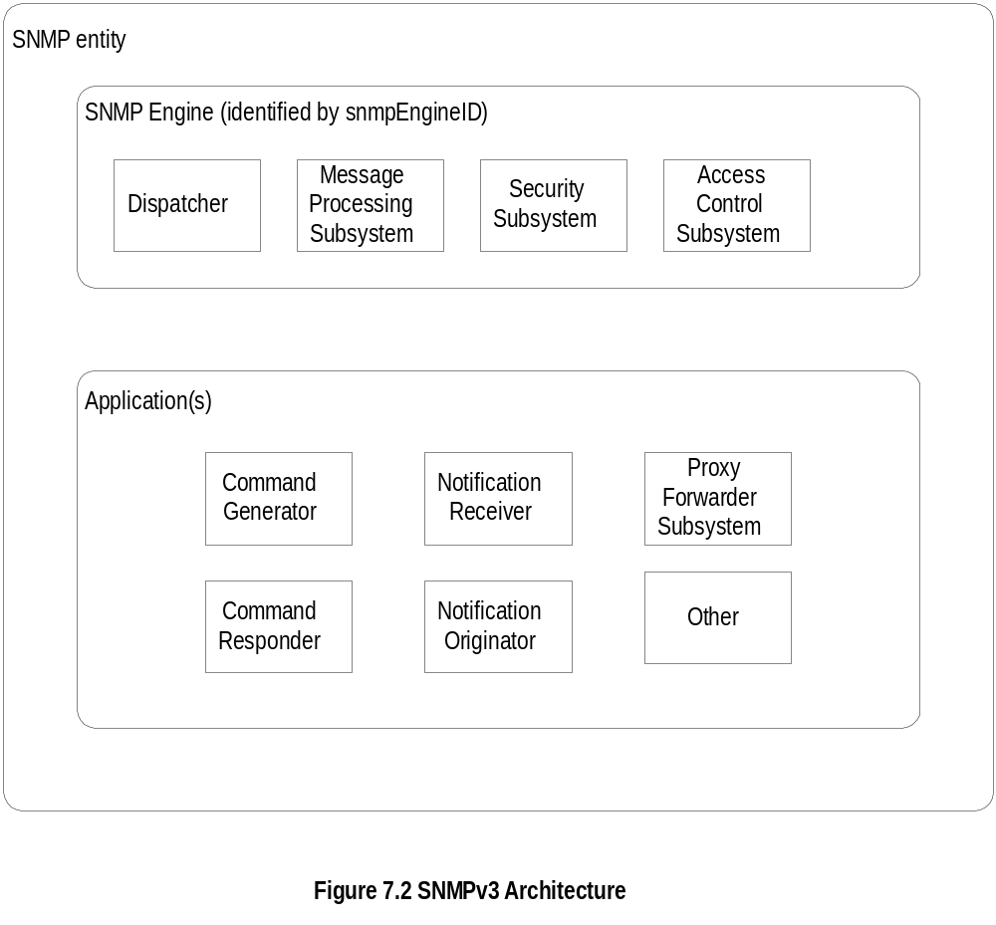
Chapter 7
Architecture
  Notes
SNMP entity is a node with an SNMP management
element - either an agent or manager or both
Three names associated with an entity
  Entities: SNMP engine
  Identities: Principal and security name
  Management Information: Context engine
Network Management: Principles and Practice
© Mani Subramanian 2000
7-4

Slide 5
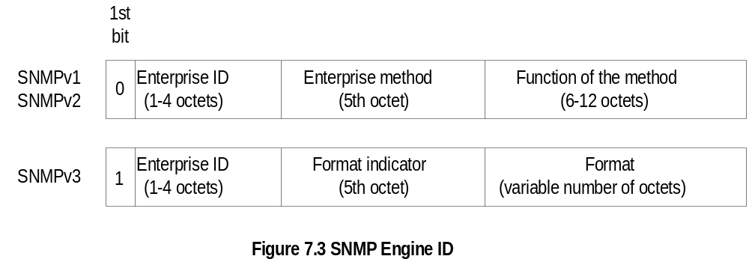
Chapter 7
SNMP Engine ID
  Notes
Each SNMP engine has a unique ID: snmpEngineID
Acme Networks {enterprises 696}
SNMPv1 snmpEngineID ‘000002b8’H
SNMPv3 snmpEngineID ‘800002b8’H
(the 1st octet is 1000 0000)
Network Management: Principles and Practice
© Mani Subramanian 2000
7-5

Slide 6
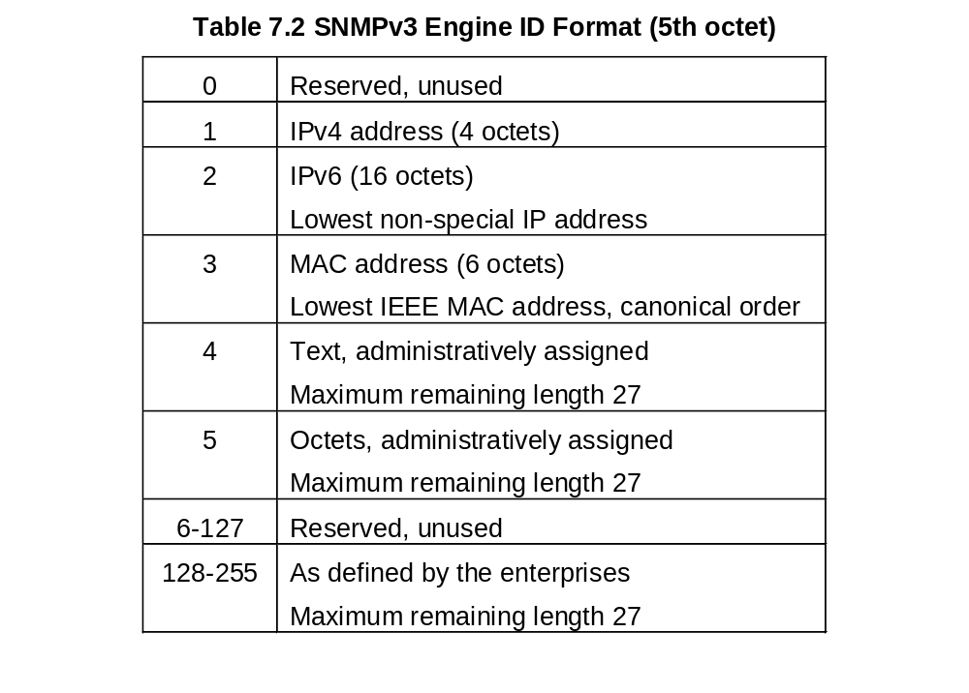
Chapter 7
SNMPv3 Engine ID Format
5th Octet
  Notes
For SNMPv1 and SNMPv2:
  Octet 5 is the method
  Octet 6-12 is IP address
Examples: IBM host IP address 10.10.10.10
SNMPv1: 00 00 00 02 01 0A 0A 0A 0A 00 00 00
SNMPv3: 10 00 00 02 02 00 00 00 00 00 00 00 0A 0A 0A 0A
Network Management: Principles and Practice
© Mani Subramanian 2000
7-6

Slide 7
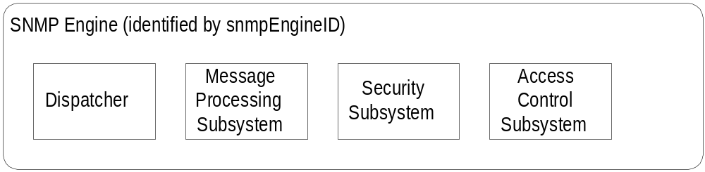
Chapter 7
Dispatcher
One dispatcher in an SNMP engine
Handles multiple version messages
Interfaces with application modules, network, and
message processing models
Three components for three functions
  Transport mapper delivers messages over the
  transport protocol
  Message Dispatcher routes messages between
  network and appropriate module of MPS
  PDU dispatcher handles messages between
  application and MSP
  Notes
Network Management: Principles and Practice
© Mani Subramanian 2000
7-7

Slide 8
Chapter 7
Message Processing Subsystem
Contains one or more Message Processing Models
One MPM for each SNMP version
SNMP version identified in the header
  Notes
Network Management: Principles and Practice
© Mani Subramanian 2000
7-8

Slide 9
Chapter 7
Security and Access Control
Security at the message level
  Authentication
  Privacy of message via secure communication
Flexible access control
  Who can access
  What can be accessed
  Flexible MIB views
  Notes
Network Management: Principles and Practice
© Mani Subramanian 2000
7-9

Slide 10
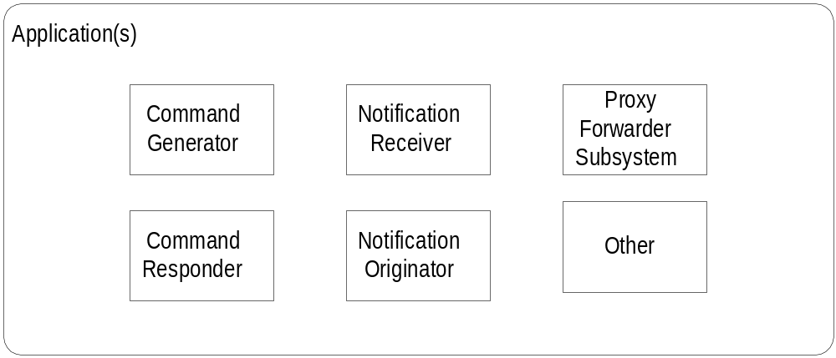
Chapter 7
Applications
Application Example
Command generator get-request
Command responder get-response
Notification receiver trap generation
Notification receiver trap processing
Proxy Forwarder get-bulk to get-next
(SNMP versions only)
Other Special application
  Notes
Network Management: Principles and Practice
© Mani Subramanian 2000
7-10

Slide 11
Chapter 7
Names
SNMP Engine ID snmpEngineID
Principal principal
Who: person or group or application
Security Name securityName
human readable name
Context Engine ID contextEngineID
Context Name contextName
  Notes
An SNMP agent can monitor more than one
network element (context)
Examples:
SNMP Engine ID IP address
Principal John Smith
Security Name Administrator
Principal Li, David, Kristen, Rashmi,
Security Name Operator
Network Management: Principles and Practice
© Mani Subramanian 2000
7-11

Slide 12
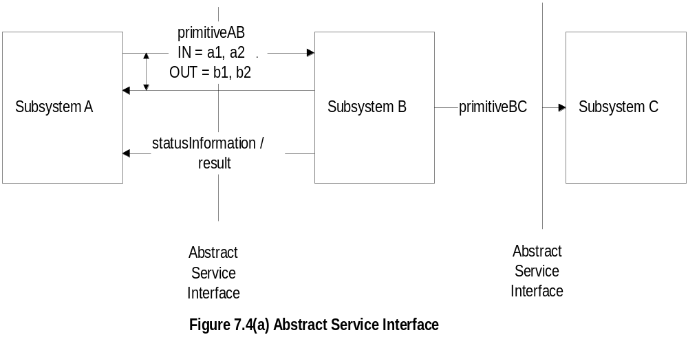
Chapter 7
Abstract Service Interface
  Notes
Abstract service interface is a conceptual interface
between modules, independent of implementation
Defines a set of primitives
Primitives associated with receiving entities except
for Dispatcher
Dispatcher primitives associated with
  messages to and from applications
  registering and un-registering of application
  modules
  transmitting to and receiving messages from
  network
IN and OUT parameters
Status information / result
Network Management: Principles and Practice
© Mani Subramanian 2000
7-12

Slide 13
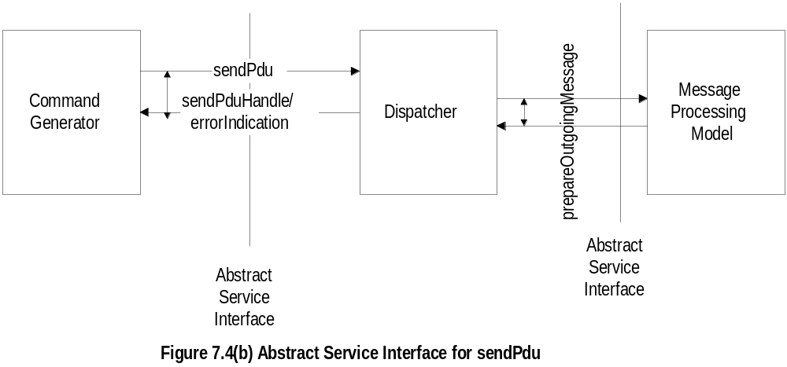
Chapter 7
sendPDU Primitive
  Notes
sendPdu request sent by the application module,
command generator, is associated with the
receiving module, dispatcher
After the message is transmitted over the network,
dispatcher sends a handle to the command generator
for tracking the response
sendPdu is the IN parameter
sendPduHandle is the OUT parameter, shown as
coupled to the IN parameter
Network Management: Principles and Practice
© Mani Subramanian 2000
7-13

Slide 14
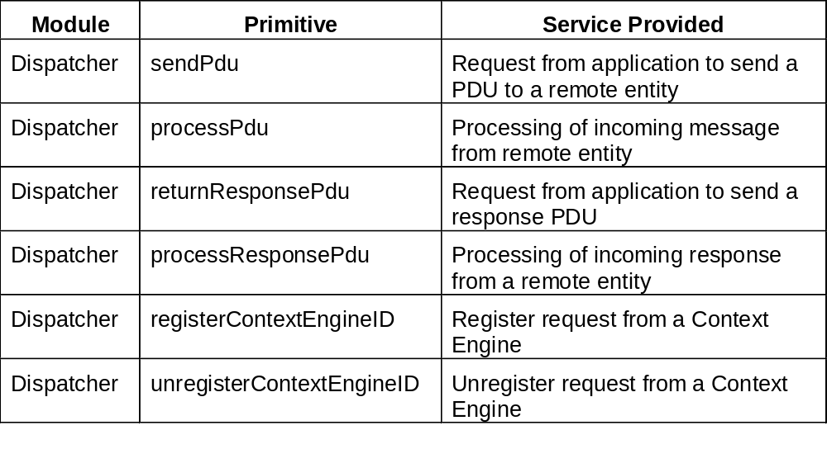
Chapter 7
Dispatcher Primitives
  Notes
Network Management: Principles and Practice
© Mani Subramanian 2000
7-14

Slide 15
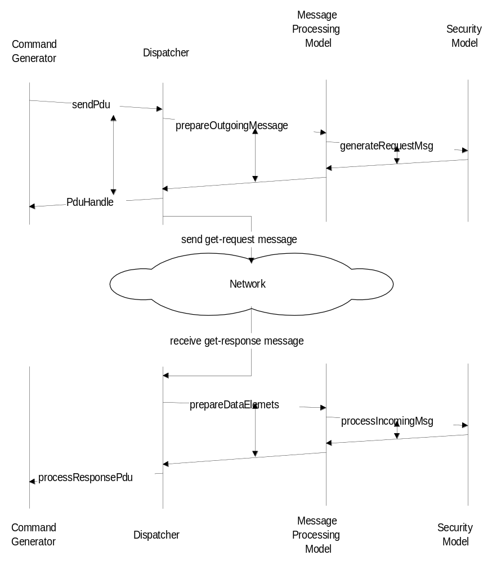
Chapter 7
Command Generator
Network Management: Principles and Practice
© Mani Subramanian 2000
7-15

Slide 16
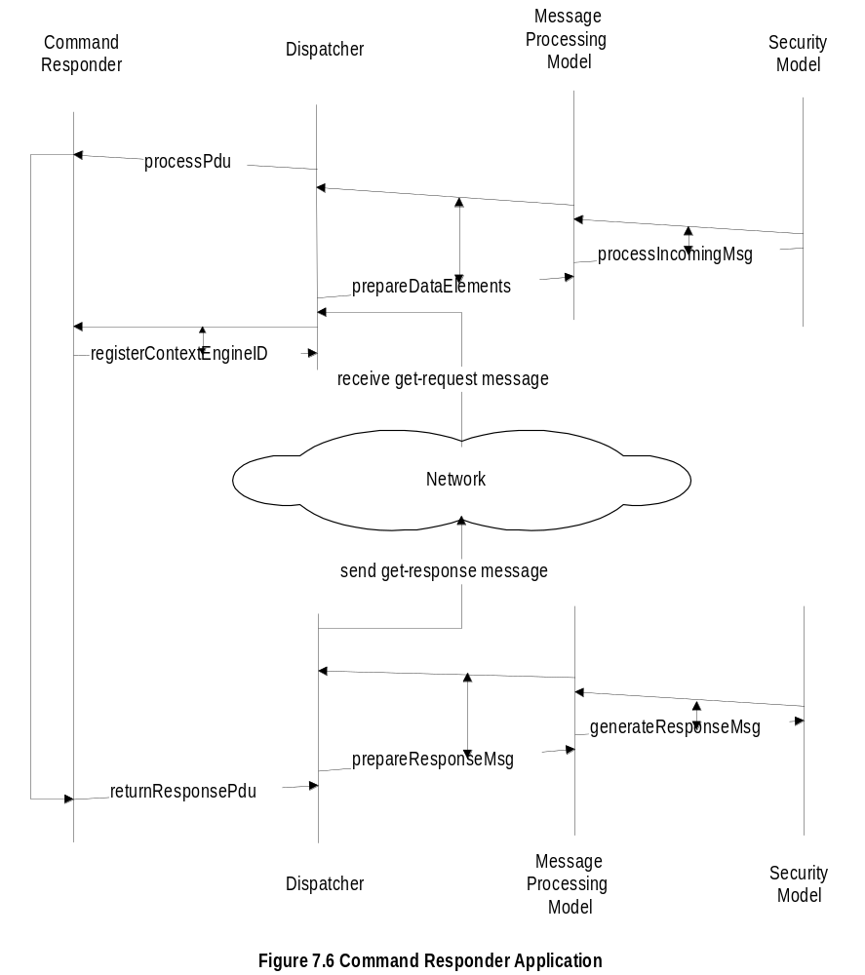
Chapter 7
Command Responder
Network Management: Principles and Practice
© Mani Subramanian 2000
7-16

Slide 17
Chapter 7
Notification / Proxy
Notification originator
  Generates trap and inform messages
  Determine target, SNMP version, and security
  Decides context information
Notification receiver
  Registers with SNMP engine
  Receives notification messages
Proxy forwarder
  Proxy server
  Handles only SNMP messages by
    Command generator
    Command responder
    Notification generator
    Report indicator
  Uses the translation table in the proxy group MIB
  Notes
Network Management: Principles and Practice
© Mani Subramanian 2000
7-17

Slide 18
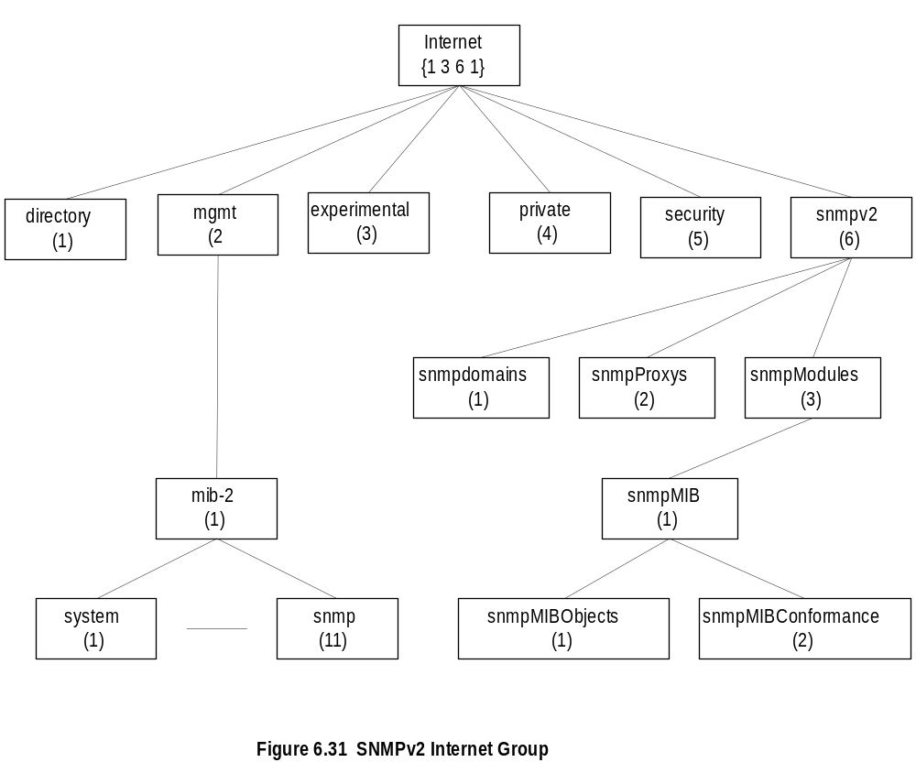
Chapter 7
SNMpV2 MIB
  Notes
SNMPv3 MIB developed under snmpModules
Security placeholder not used
Network Management: Principles and Practice
© Mani Subramanian 2000
7-18

Slide 19
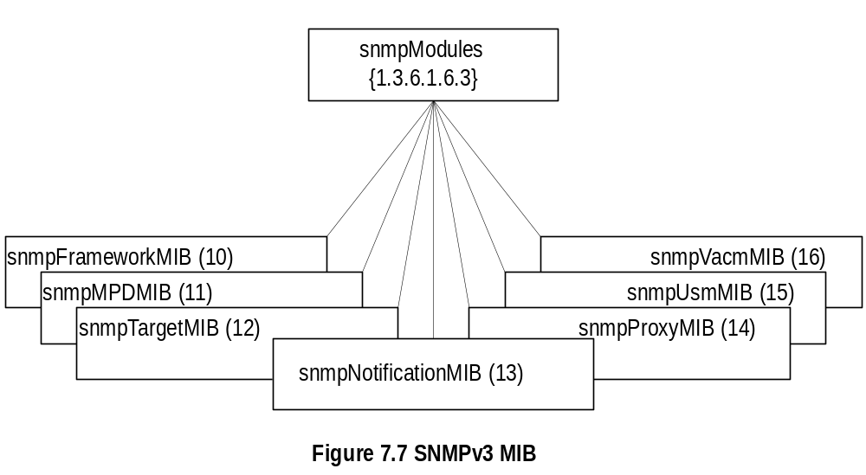
Chapter 7
SNMPv3 MIB
  Notes
snmpFrameworkMIB describes SNMP
management architecture
snmpMPDMIB identifies objects in the message
processing and dispatch subsystems
snmpTargetMIB and snmpNotificationMIB used
for notification generation
snmpProxyMIB defines translation table for proxy
forwarding
snmpUsMIB defines user-based security model
objects
snmpVacmMIB defines objects for view-based
access control
Network Management: Principles and Practice
© Mani Subramanian 2000
7-19

Slide 20
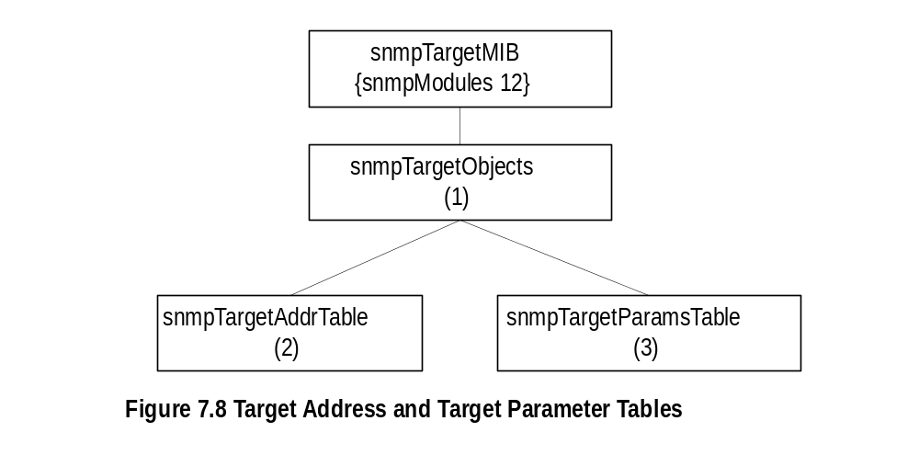
Chapter 7
SNMPv3 Target MIB
  Notes
Target MIB contains two tables
Target address table contains addresses of the
targets for notifications (see notification group)
Target address table also contains information for
establishing the transport parameters
Target address table contains reference to the
second table, target parameter table
Target parameter table contains security parameters
for authentication and privacy
Network Management: Principles and Practice
© Mani Subramanian 2000
7-20

Slide 21
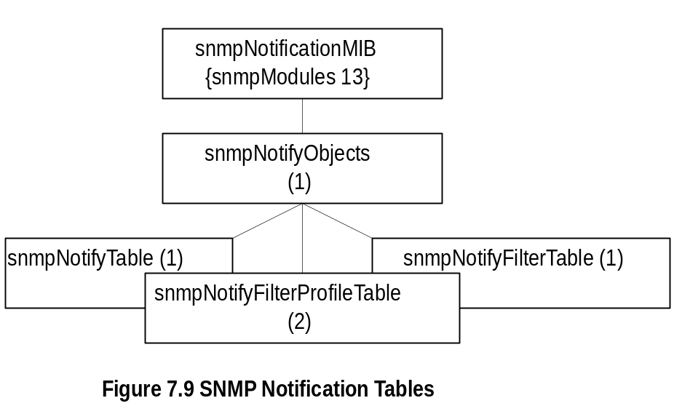
Chapter 7
SNMPv3 Notification MIB
  Notes
Notification group contains three tables
Notify table contains groups of management targets
to receive notifications and the type of notifications
The target addresses to receive notifications that
are listed in target address table (see target group)
are tagged here
Notification profile table defines filter profiles
associated with target parameters
Notification filter table contains table profiles of the
targets
Network Management: Principles and Practice
© Mani Subramanian 2000
7-21

Slide 22
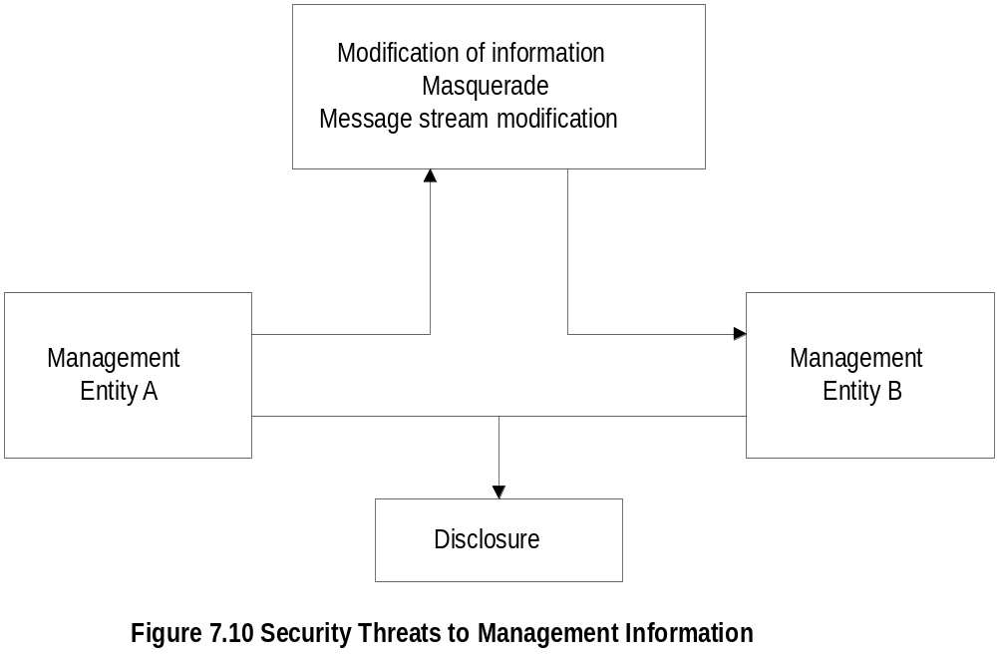
Chapter 7
Security Threats
  Notes
Modification of information: Contents modified by
unauthorized user, does not include address change
Masquerade: change of originating address by
unauthorized user
Fragments of message altered by an unauthorized
user to modify the meaning of the message
Disclosure is eavesdropping
Disclosure does not require interception of message
Denial of service and traffic analysis are not con-
sidered as threats
Network Management: Principles and Practice
© Mani Subramanian 2000
7-22

Slide 23
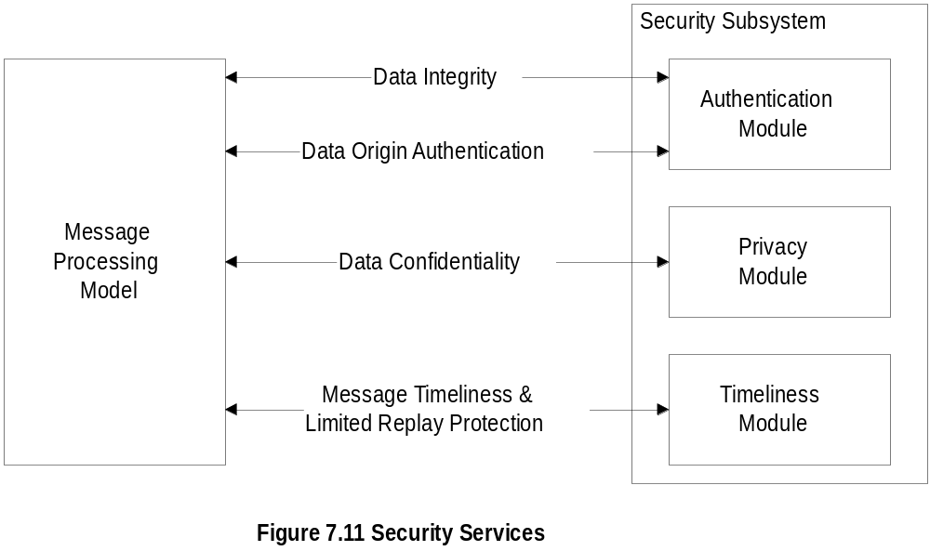
Chapter 7
Security Services
  Notes
Authentication
  Data integrity:
    HMAC-MD5-96 / HMAC-SHA-96
  Data origin authentication
    Append to the message a unique Identifier
    associated with authoritative SNMP engine
Privacy / confidentiality:
  Encryption
Timeliness:
  Authoritative Engine ID, No. of engine boots
  and time in seconds
Network Management: Principles and Practice
© Mani Subramanian 2000
7-23

Slide 24
Chapter 7
Role of SNMP Engines
Non-Authoritative Engine
(NMS)
Authoritative Engine
(Agent)
  Notes
Responsibility of Authoritative engine:
  Unique SNMP engine ID
  Time-stamp
Non-authoritative engine should keep a table of the
time-stamp and authoritative engine ID
Network Management: Principles and Practice
© Mani Subramanian 2000
7-24

Slide 25
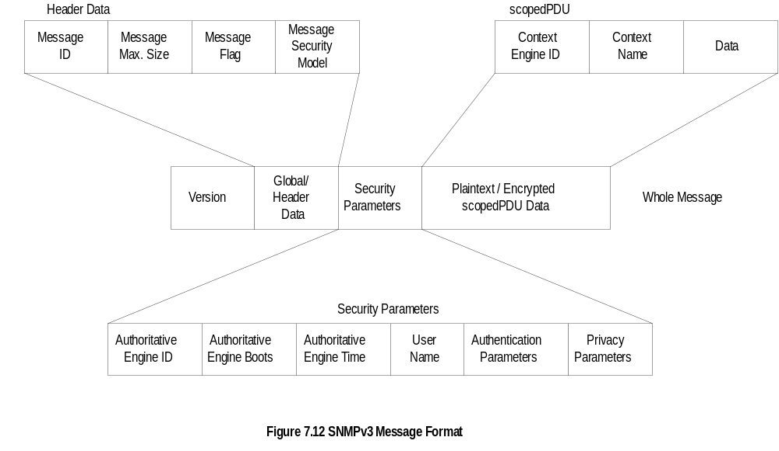
Chapter 7
SNMPv3 Message Format
Network Management: Principles and Practice
© Mani Subramanian 2000
7-25

Slide 26
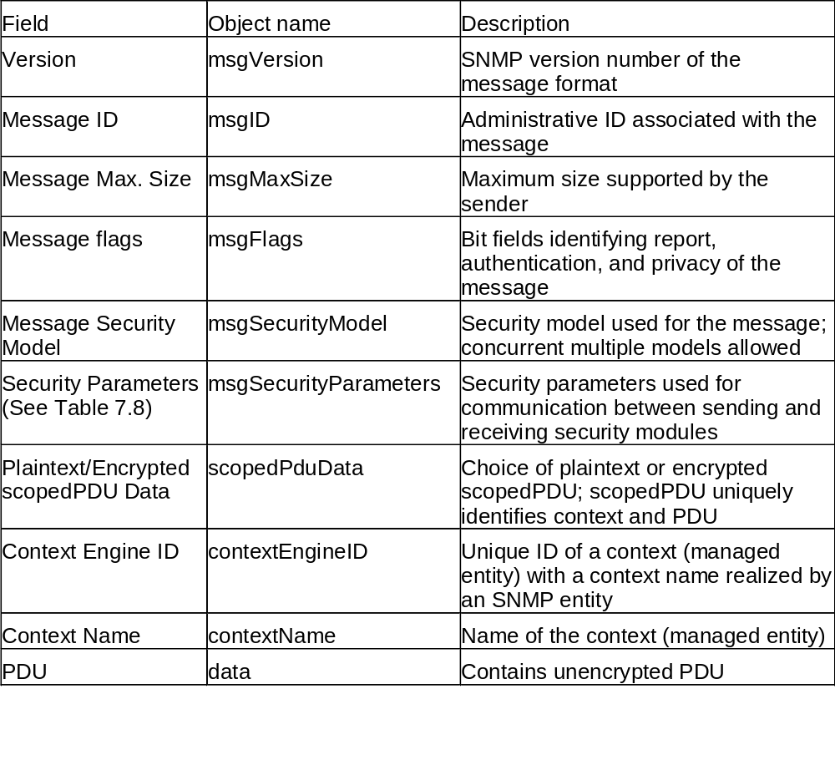
Chapter 7
SNMPv3 Message Format
Network Management: Principles and Practice
© Mani Subramanian 2000
7-26

Slide 27
Chapter 7
User-Based Security Model
Based on traditional user name concept
USM primitives across abstract service interfaces
  Authentication service primitives
    authenticateOutgoingMsg
    authenticateIncomingMsg
  Privacy Services
    encryptData
    decryptData
  Notes
Network Management: Principles and Practice
© Mani Subramanian 2000
7-27

Slide 28
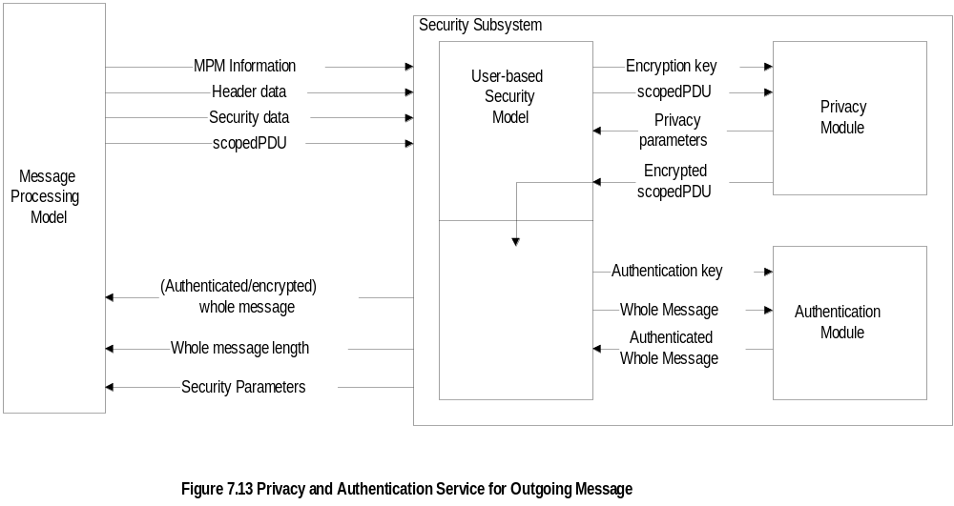
Chapter 7
Secure Outgoing Message
  Notes
USM invokes privacy module w/ encryption key and scopedPDU
Privacy module returns privacy parameters and encrypted scopedPDU
USM then invokes the authentication module w/authentication key and
whole message and receives authenticated whole message
Network Management: Principles and Practice
© Mani Subramanian 2000
7-28

Slide 29
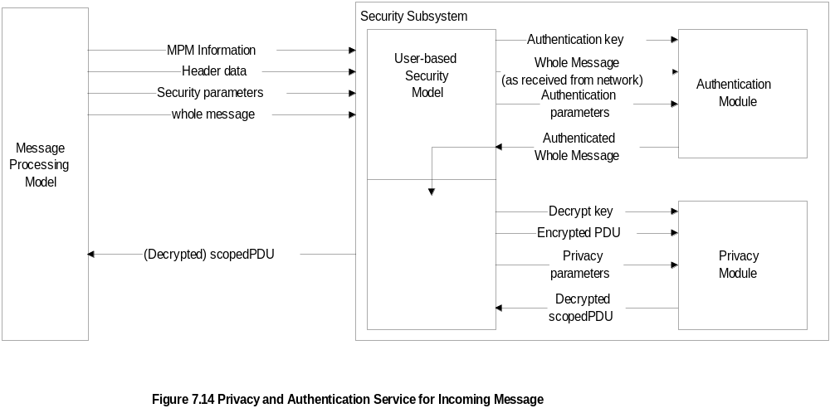
Chapter 7
Secure Incoming Message
  Notes
Processing secure incoming message reverse of secure outgoing message
Authentication validation done first by the authentication module
Decryption of the message done then by the privacy module
Network Management: Principles and Practice
© Mani Subramanian 2000
7-29

Slide 30
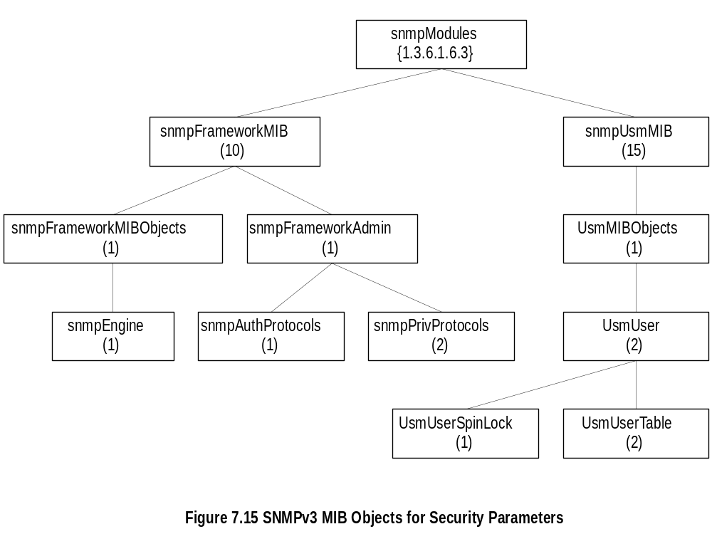
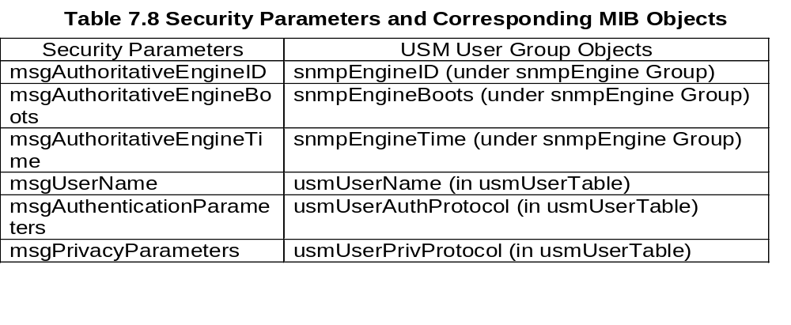
Chapter 7
Security Parameters
  Notes
Network Management: Principles and Practice
© Mani Subramanian 2000
7-30

Slide 31
Chapter 7
Privacy Module
Encryption and decryption of scoped PDU
(context engine ID, context name, and PDU)
CBC - DES (Cipher Block Chaining - Data
Encryption Standard) symmetric protocol
Encryption key (and initialization vector)
made up of secret key (user password), and
timeliness value
Privacy parameter is salt value (unique for
each packet) in CBC-DES
  Notes
Network Management: Principles and Practice
© Mani Subramanian 2000
7-31

Slide 32
Chapter 7
Authentication Key
Secret key for authentication
Derived from user (NMS) password
MD5 or SHA-1 algorithm used
Authentication key is digest2
  Notes
Procedure:
1. Derive digest0:
Password repeated until it forms 2²⁰ octets.
2. Derive digest1:
Hash digest0 using MD5 or SHA-1.
3. Derive digest2:
Concatenate authoritative SNMP engine ID and
digest1 and hash with the same algorithm
Network Management: Principles and Practice
© Mani Subramanian 2000
7-32

Slide 33
Chapter 7
Authentication Parameters
Authentication parameter is Hashed Message
Access Code (HMAC)
HMAC is 96-bit long (12 octets)
Derived from authorization key (authKey)
  Notes
Procedure:
1. Derive extendedAuthKey:
Supplement authKey with 0s to get 64-byte string
2. Define ipad, opad, K1, and K2:
ipad = 0x36 (00110110) repeated 64 times
opad = 0x5c (01011100) repeated 64 times
K1 = extendedAuthKey XOR ipad
K2 = extendedAuthKey XOR opad
3. Derive HMAC by hashing algorithm used
HMAC = H (K2, H (K1, wholeMsg))
Network Management: Principles and Practice
© Mani Subramanian 2000
7-33

Slide 34
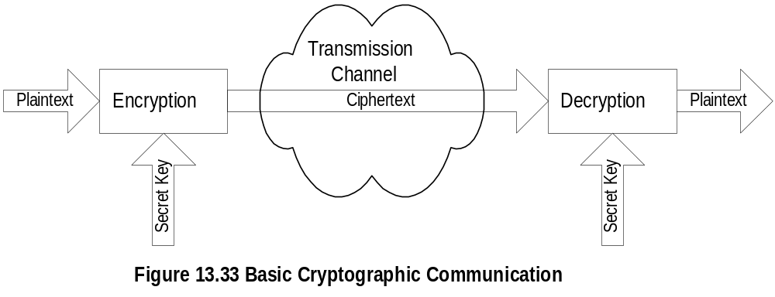
Chapter 7
Encryption Protocol
Cipher Block Chaining mode of
Data Encryption Standard (CBC-DES) protocol
16-octet privKey is secret key
First 8-octet of privKey used as 56-bit DES key;
(Only 7 high-order bits of each octet used)
Last 8-octet of privKey used as pre-initialization vector
  Notes
CBC Mode
  Plaintext divided into 64-bit blocks
  Each block is XOR-d with ciphertext of the
  previous block and then encrypted
  Use pre-IV (initialization vector) for prefixing
  the first message block
Network Management: Principles and Practice
© Mani Subramanian 2000
7-34

Slide 35
Chapter 7
Access Control
View-based Access Control Model
  Groups: Name of the group comprising
  security model and security name:
  In SNMPv1, is community name
  Security Level
    no authentication - no privacy
    authentication - no privacy
    authentication - privacy
  Contexts: Names of the context
  MIB Views and View Families
    MIB view is a combination of view subtrees
  Access Policy
    read-view
    write-view
    notify-view
    not-accessible
  Notes
Network Management: Principles and Practice
© Mani Subramanian 2000
7-35

Slide 36
Chapter 7
VCAM Process
Answers 6 questions:
1. Who are you (group)?
2. Where do you want to go (context)?
3. How secured are you to access the information
(security model and security level)?
4. Why do you want to access the information
(read, write, or send notification)?
5. What object (object type) do you want to
access?
6. Which object (object instance) do you want to
access?
  Notes
Network Management: Principles and Practice
© Mani Subramanian 2000
7-36

Slide 37
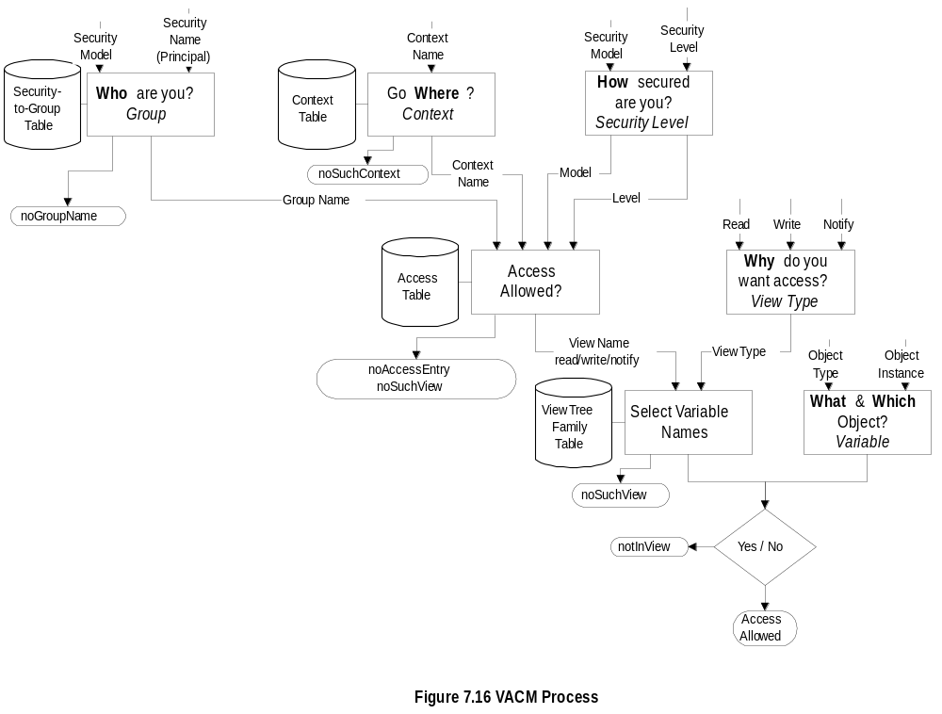
Chapter 7
VCAM Process
Network Management: Principles and Practice
© Mani Subramanian 2000
7-37

Slide 38
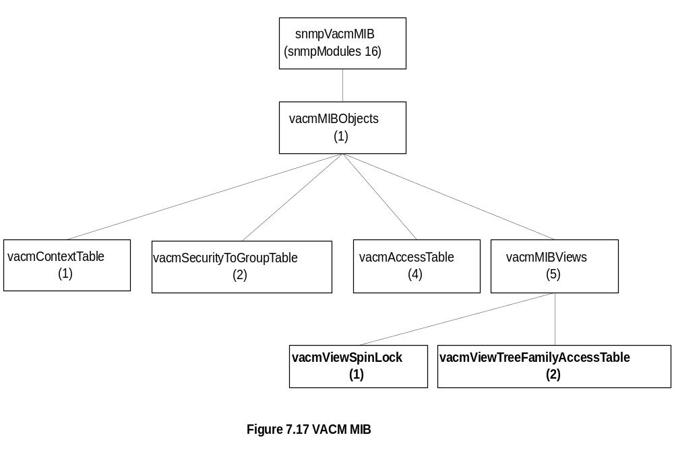
Chapter 7
VACM MIB
  Notes
Four tables used to achieve access control
  Group defined by security-to-group table
  Context defined by context table
  Access determines access allowed and the
  view name
  View tree family table determines the MIB view,
  which is very flexible
Network Management: Principles and Practice
© Mani Subramanian 2000
7-38

Slide 39
Chapter 7
MIB Views
Simple view:
system 1.3.6.1.2.1.1
Complex view:
All information relevant to a particular interface -
system and interfaces groups
Family view subtrees
View with all columnar objects in a row appear
as separate subtree.
OBJECT IDENTIFIER (family name)
paired with
bit-string value (family mask)
to select or suppress columnar objects
  Notes
Network Management: Principles and Practice
© Mani Subramanian 2000
7-39

Slide 40
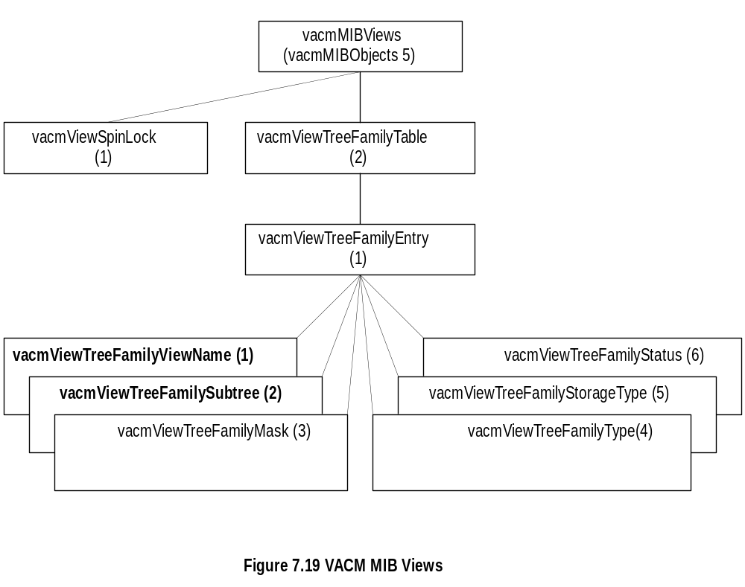
Chapter 7
VACM MIB View
  Notes
Example:
Family view name = “system”
Family subtree = 1.3.6.1.2.1.1
Family mask = “” (implies all 1s by convention)
Family type = 1 (implies value to be included)
Network Management: Principles and Practice
© Mani Subramanian 2000
7-40

